Slide 1
Basic Datapath Operations
Load operation: Load data from data memory to RF
ALU operation: Transforms data by passing one or two RF register values through ALU, performing operation (ADD, SUB, AND, OR, etc.), and writing back into RF.
Store operation: Stores RF register value back into data memory
Each operation can be done in one clock cycle
Data memory D
Data memory D
Data memory D
n-bit
n-bit
n-bit
2x
1
2x
1
2x
1
a
Register file RF
Register file RF
Register file RF
ALU
ALU
ALU
Load operation
ALU operation
Store operation

Slide 2
Basic Datapath Operations
Q: Which are valid single-cycle operations for given datapath?
  Move D[1] to RF[1] (i.e., RF[1] = D[1])
    A: YES – That's a load operation
  Store RF[1] to D[9] and store RF[2] to D[10]
    A: NO – Requires two separate store operations
  Add D[0] plus D[1], store result in D[9]
    A: NO – ALU operation (ADD) only works with RF. Requires two load operations (e.g., RF[0]=D[0]; RF[1]=D[1], an ALU operation (e.g., RF[2]=RF[0]+RF[1]), and a store operation (e.g., D[9]=RF[2])
a
Data memory D
Data memory D
Data memory D
n-bit
n-bit
n-bit
2x
1
2x
1
2x
1
Register file RF
Register file RF
Register file RF
ALU
ALU
ALU
Load operation
ALU operation
Store operation

Slide 3
Basic Architecture – Control Unit
D[9] = D[0] + D[1] – requires a sequence of four datapath operations:
      0: RF[0] = D[0]
      1: RF[1] = D[1]
      2: RF[2] = RF[0] + RF[1]
      3: D[9] = RF[2]
Each operation is an instruction
  Sequence of instructions – program
  Looks cumbersome, but that's the world of programmable processors – Decomposing desired computations into processor-supported operations
  Store program in Instruction memory
  Control unit reads each instruction and executes it on the datapath
    PC: Program counter – address of current instruction
    IR: Instruction register – current instruction
Instruction memory
I
0: RF[0]=D[0]
Data memory D
a
1: RF[1]=D[1]
2: RF[2]=RF[0]+RF[1]
3: D[9]=RF[2]
n-bit
2
x
1
PC
IR
Register file RF
Controller
ALU
Control unit
Datapath

Slide 4
Basic Architecture – Control Unit
To carry out each instruction, the control unit must:
  Fetch – Read instruction from inst. mem.
  Decode – Determine the operation and operands of the instruction
  Execute – Carry out the instruction's operation using the datapath
Instruction memory
I
0: RF[0]=D[0]
1: RF[1]=D[1]
Instruction memory
I
2: RF[2]=RF[0]+RF[1]
0: RF[0]=D[0]
3: D[9]=RF[2]
1: RF[1]=D[1]
Instruction memory
I
2: RF[2]=RF[0]+RF[1]
0: RF[0]=D[0]
Data memory D
3: D[9]=RF[2]
1: RF[1]=D[1]
D[0]: 99
2: RF[2]=RF[0]+RF[1]
PC
I
R
3: D[9]=RF[2]
0
−>
1
RF[0]=D[0]
PC
I
R
n-bit
1
RF[0]=D[0]
2
x
1
PC
I
R
1
RF[0]=D[0]
Controller
Register file RF
Controller
R[0]: ??
→ 99
a
Control unit
"load"
Controller
(
a
)
Fetch
Control unit
ALU
(
b
)
Decode
Control unit
Datapath
Execute
(
c
)

Slide 5
Basic Architecture – Control Unit
To carry out each instruction, the control unit must:
  Fetch – Read instruction from inst. mem.
  Decode – Determine the operation and operands of the instruction
  Execute – Carry out the instruction's operation using the datapath
Instruction memory
I
0: RF[0]=D[0]
1: RF[1]=D[1]
Instruction memory
I
2: RF[2]=RF[0]+RF[1]
0: RF[0]=D[0]
3: D[9]=RF[2]
1: RF[1]=D[1]
Instruction memory
I
2: RF[2]=RF[0]+RF[1]
0: RF[0]=D[0]
Data memory D
3: D[9]=RF[2]
1: RF[1]=D[1]
D[1]: 102
2: RF[2]=RF[0]+RF[1]
PC
I
R
3: D[9]=RF[2]
1
−>
2
RF[1]=D[1}
PC
I
R
n-bit
2
RF[1]=D[1]
2
x
1
PC
I
R
2
RF[1]=D[1]
Controller
Register file RF
Controller
R[1]: ??
→ 102
a
Control unit
"load"
Controller
(
a
)
Fetch
Control unit
ALU
(
b
)
Decode
Control unit
Datapath
Execute
(
c
)

Slide 6
Basic Architecture – Control Unit
To carry out each instruction, the control unit must:
  Fetch – Read instruction from inst. mem.
  Decode – Determine the operation and operands of the instruction
  Execute – Carry out the instruction's operation using the datapath
Instruction memory
I
0: RF[0]=D[0]
1: RF[1]=D[1]
Instruction memory
I
2: RF[2]=RF[0]+RF[1]
0: RF[0]=D[0]
3: D[9]=RF[2]
1: RF[1]=D[1]
Instruction memory
I
2: RF[2]=RF[0]+RF[1]
0: RF[0]=D[0]
Data memory D
3: D[9]=RF[2]
1: RF[1]=D[1]
2: RF[2]=RF[0]+RF[1]
PC
I
R
3: D[9]=RF[2]
2
−>
3
RF[2]=RF[0]+RF[1]
PC
I
R
n-bit
3
RF[2]=RF[0]+RF[1]
2
x
1
PC
I
R
3
RF[2]=RF[0]+RF[1]
Controller
Register file RF
Controller
R[2]: ??
→ 201
a
Control unit
"ALU (add)"
Controller
99
102
(
a
)
201
Fetch
Control unit
ALU
(
b
)
Decode
Control unit
Datapath
Execute
(
c
)

Slide 7
Basic Architecture – Control Unit
To carry out each instruction, the control unit must:
  Fetch – Read instruction from inst. mem.
  Decode – Determine the operation and operands of the instruction
  Execute – Carry out the instruction's operation using the datapath
Instruction memory
I
0: RF[0]=D[0]
1: RF[1]=D[1]
Instruction memory
I
2: RF[2]=RF[0]+RF[1]
0: RF[0]=D[0]
3: D[9]=RF[2]
1: RF[1]=D[1]
Instruction memory
I
2: RF[2]=RF[0]+RF[1]
0: RF[0]=D[0]
Data memory D
3: D[9]=RF[2]
1: RF[1]=D[1]
D[9]=??
→ 201
2: RF[2]=RF[0]+RF[1]
PC
I
R
3: D[9]=RF[2]
3
−>
4
D[9]=RF[2]
PC
I
R
n-bit
4
D[9]=RF[2]
2
x
1
PC
I
R
4
D[9]=RF[2]
Controller
Register file RF
Controller
R[2]: 201
a
Control unit
"store"
Controller
(
a
)
Fetch
Control unit
ALU
(
b
)
Decode
Control unit
Datapath
Execute
(
c
)

Slide 8
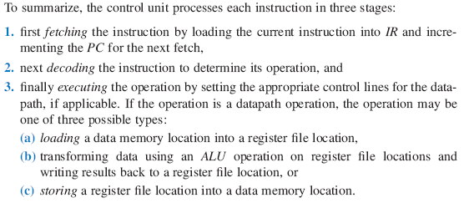
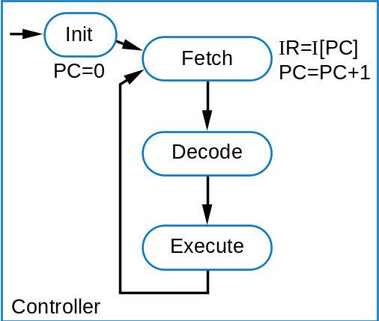
Basic Architecture – Control Unit
Instruction memory
I
0: RF[0]=D[0]
Data memory D
1: RF[1]=D[1]
2: RF[2]=RF[0]+RF[1]
3: D[9]=RF[2]
n-bit
2
x
1
PC
IR
Register file RF
Controller
ALU
Control unit
Datapath

Slide 9
Creating a Sequence of Instructions
Q: Create sequence of instructions to compute D[3] = D[0]+D[1]+D[2] on earlier-introduced processor
A1: One possible sequence
  First load data memory locations into register file
    R[3] = D[0]
    R[4] = D[1]
    R[2] = D[2]
    (Note arbitrary register locations)
A2: Alternative sequence
  First load D[0] and D[1] and add them
    R[1] = D[0]
    R[2] = D[1]
    R[1] = R[1] + R[2]
a
a
  Next, load D[2] and add
    R[2] = D[2]
    R[1] = R[1] + R[2]
  Next, perform the additions
    R[1] = R[3] + R[4]
    R[1] = R[1] + R[2]
  Finally, store result
    D[3] = R[1]
  Finally, store result
    D[3] = R[1]

Slide 10
Number of Cycles
Q: How many cycles are needed to execute six instructions using the earlier-described processor?
A: Each instruction requires 3 cycles – 1 to fetch, 1 to decode, and 1 to execute
  Thus, 6 instr * 3 cycles/instr = 18 cycles
a

Slide 11
Three-Instruction Programmable Processor
Instruction Set – List of allowable instructions and their representation in memory, e.g.,
  Load instruction—0000 r₃r₂r₁r₀ d₇d₆d₅d₄d₃d₂d₁d₀
  Store instruction—0001 r₃r₂r₁r₀ d₇d₆d₅d₄d₃d₂d₁d₀
  Add instruction—0010 ra₃ra₂ra₁ra₀ rb₃rb₂rb₁rb₀ rc₃rc₂rc₁rc₀
Desired program
0: RF[0]=D[0]
1: RF[1]=D[1]
2: RF[2]=RF[0]+RF[1]
a
3: D[9]=RF[2}
a
Instruction memory
I
0: 0000 0000 00000000
Instructions in 0s and 1s – machine code
1: 0000 0001 00000001
2: 0010 0010 0000 0001
3: 0001 0010 00001001
opcode
operands

Slide 12
Program for Three-Instruction Processor
Desired program
0: RF[0]=D[0]
1: RF[1]=D[1]
2: RF[2]=RF[0]+RF[1]
3: D[9]=RF[2}
Computes
Instruction memory
I
D[9]
=
D[0]
+
D[1]
0: 0000 0000 00000000
Data memory D
1: 0000 0001 00000001
2: 0010 0010 0000 0001
3: 0001 0010 00001001
n-bit
2
⋅
1
PC
I
R
Register file RF
Controller
ALU
Control unit
Datapath

Slide 13
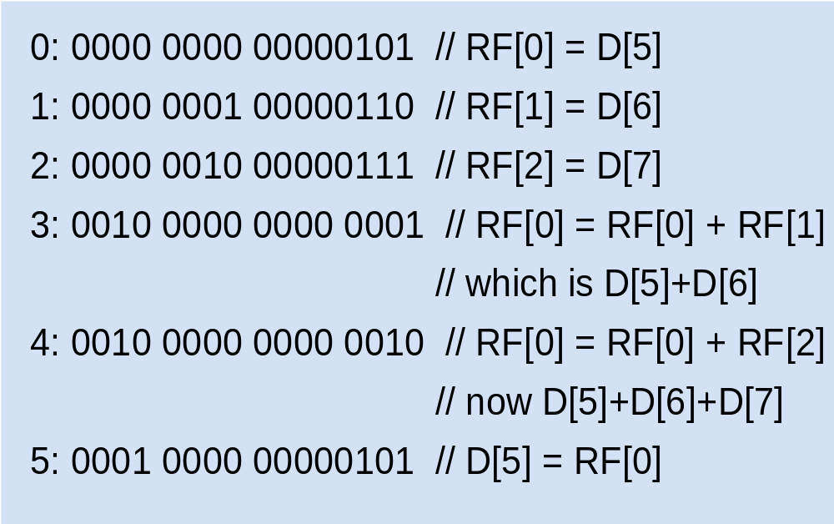
Program for Three-Instruction Processor
Another example program in machine code
  Compute D[5] = D[5] + D[6] + D[7]
  Load instruction—0000 r₃r₂r₁r₀ d₇d₆d₅d₄d₃d₂d₁d₀
  Store instruction—0001 r₃r₂r₁r₀ d₇d₆d₅d₄d₃d₂d₁d₀
  Add instruction—0010 ra₃ra₂ra₁ra₀ rb₃rb₂rb₁rb₀ rc₃rc₂rc₁rc₀

Slide 14
Machine code (0s and 1s) hard to work with
Assembly code – Uses mnemonics
  Load instruction—MOV Ra, d
    specifies the operation RF[a]=D[d]. a must be 0,1, ..., or 15—so R0 means RF[0], R1 means RF[1], etc. d must be 0, 1, ..., 255
  • Store instruction—MOV d, Ra
    specifies the operation D[d]=RF[a]
  • Add instruction—ADD Ra, Rb, Rc
    specifies the operation RF[a]=RF[b]+RF[c]
Desired program
0: 0000 0000 00000000
0: MOV R0, 0
1: MOV R1, 1
2: ADD R2, R0, R1
3: MOV 9, R2
0: RF[0]=D[0]
1: RF[1]=D[1]
1: 0000 0001 00000001
2: RF[2]=RF[0]+RF[1]
2: 0010 0010 0000 0001
3: D[9]=RF[2]
3: 0001 0010 00001001
machine code
assembly code

Slide 15
Control-Unit and Datapath for Three-Instruction Processor
To design the processor, we can begin with a high-level state machine description of the processor's behavior
Init
I
I
Fetch
R:=
[PC]
PC:=0
PC:=PC+1
Decode
op=="0000"
op=="0001"
op=="0010"
Load
Store
Add
RF[ra]:=D[d]
D[d]:=RF[ra]
RF[ra] :=
RF[rb]+
RF[rc]

Slide 16
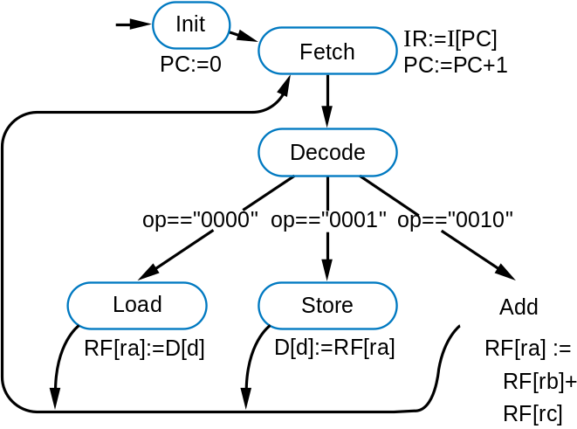
Control-Unit and Datapath for Three-Instruction Processor
Create detailed connections among components
D_addr 8
addr
D
addr
rd
data
I
D_rd
16
D_wr
rd
256
x
16
16
wr
PC
I
R
W_data
R_data
clr
up
Id
16
16
RF_s
1
0
s
16-bit
PC_clr
I_rd
IR_ld
2
x
1
PC_inc
16
RF_W_addr
4
W_addr
W_data
RF_W_wr
W_wr
RF_Rp_addr
4
Rp_addr
Controller
RF_Rp_rd
Rp_rd
16
x
16
RF_Rq_addr
4
Rq_addr
RF
RF_Rq_rd
Rq_rd
16
Rp_data
Rq_data
alu_s0
16
16
s0
A
ALU
B
Control unit
Datapath
16

Slide 17

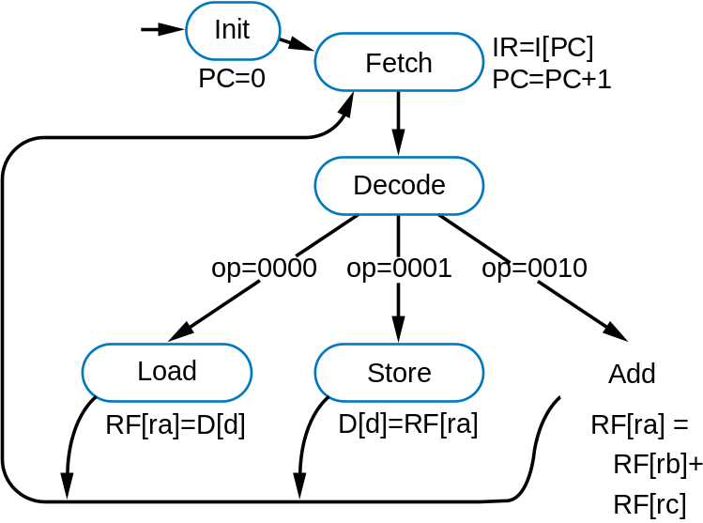
Control-Unit and Datapath for Three-Instruction Processor
D_addr 8
addr
D
addr
rd
data
I
D_rd
16
rd
x
D_wr
wr
256
16
16
W_data
R_data
PC
I
R
clr
up
Id
16
Init
I
R=
I
[PC] PC=PC+1
16
a
Fetch
RF_s
1
0
PC=0
I
_rd=1 PC_inc=1
s
16-bit
PC_ clr=1
I
R_ld=1
2
x
1
16
Decode
RF_W_addr
4
W_addr
W_data
RF_W_wr
W_wr
op=0000
op=0001
op=0010
RF_Rp_addr
4
Rp_addr
Controller
RF_Rp_rd
Rp_rd
16
x
16
Execute
states
RF_Rq_addr
4
Rq_addr
RF
Load
Store
Add
RF_Rq_rd
Rq_rd
RF[ra]=D[d]
D[d]=RF[ra]
RF[ra] = RF[rb]+
16
Rp_data
Rq_data
D_addr=d
D_addr=d
RF[rc]
alu_s0
16
16
D_rd=1
D_wr=1
RF_Rp_addr=rb
RF_s=1
RF_s=X
RF_Rp_rd=1
A
B
RF_W_addr=ra
RF_Rp_addr=ra
RF_s=0
s0
ALU
RF_W_wr=1
RF_Rp_rd=1
RF_Rq_addr=rc
16
RF_Rq _rd=1
Control unit
Datapath
RF_W_addr=ra
RF_W_wr=1
alu_s0=1

